Slide 1

Cab Business Analysis
G2M Insights for a Cab Investment Firm
17th March 2023
By: Yash Jayesh Doshi

Slide 2
Agenda
Project Objective
About the Data
About the merged data
Overall Business Analysis
EDA Results
Hypothesis Testing
Recommendations

Slide 3
Project Objective
XYZ is a private firm in US. Due to remarkable growth in the Cab Industry in last few years and multiple key players in the market, it is planning for an investment in Cab industry and as per their Go-to-Market(G2M) strategy they want to understand the market before taking final decision.
I have been provided with multiple data sets that contains information on 2 cab companies. Each file (data set) provided represents different aspects of the customer profile. XYZ is interested in using my actionable insights to help them identify the right company to make their investment.
The outcome of your delivery will be a presentation to XYZ’s Executive team. This presentation will be judged based on the visuals provided, the quality of your analysis and the value of your recommendations and insights.

Slide 4
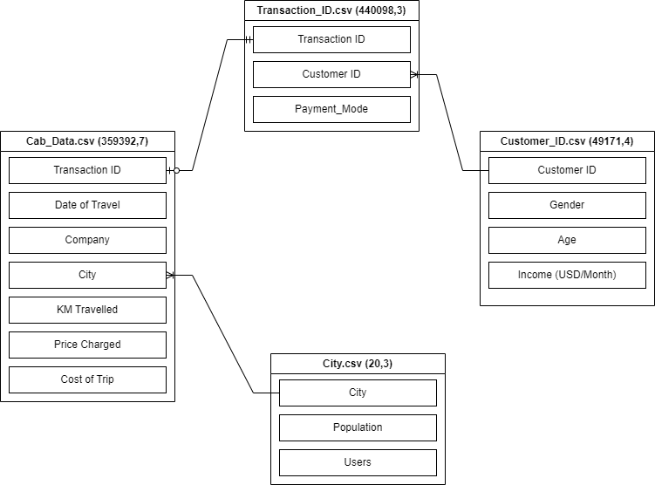
About the Data
No missing values were found.
Outliers were detected in ‘Price Charged’ feature, but since it was related to high value of ‘KM Travelled’ (which didn’t have outliers), the outliers haven’t been removed.
Data from Transaction_ID.csv, Customer_ID.csv and City.csv was left-merged into Cab_Data.csv to create a master dataframe, to be used for further analysis.
Fig: ER Diagram

Slide 5
About the merged data
Merged Dataframe
Existing Columns | Added Columns
Transaction ID | Year
Date of Travel | Month name
Company | Day name
City | Month-year (mm-yyyy)
KM Travelled | Day number
Price Charged | Distance Category
Cost of Trip | Age Category
Customer ID | Income Category
Payment Mode | Profit
Gender | Profit %
Age
Income (USD/Month)
Population
Users
Category | How it was made?
Distance Category | Short trip: up to 10 kms Medium trip: 10 to 30 kms Long Trip: more than 30 kms
Age Category | 18-30, 30-45, 45-60, 60+
Income Category | Low: up to 1006 USD/Month (No values) Lower-Middle: 1006 to 3955 USD/Month Upper-Middle: 3955 to 12235 USD/Month High: more than 12235 USD/Month
The merged dataframe consisted of 13 features and 359392 records.
A few columns were added to help with the Exploratory Data Analysis. The final dataframe consisted of 24 features.

Slide 6
Overall Business Analysis
Opportunities
Market Growth: The private cab industry in the USA grew rapidly during this time period. According to a report by Statista, the revenue of the US ride-hailing market was estimated to be $14.3 billion in 2016 and grew to $36.5 billion in 2018, representing a compound annual growth rate of 46.5%.
Challenges
Intense Competition: With growing demand came in intense competition between private companies. According to data from Certify, a travel and expense management software company, in 2016, Uber was the most expensed ride-sharing service for business travel, accounting for 43% of all ride receipts, while taxis represented only 14% of receipts.
Technological advancements: Cab companies started leveraging technology to improve their services, increase efficiency, and reduce costs. For example, some companies started using GPS systems to optimize routes, mobile apps to book cabs, and digital payment systems to enhance convenience.
Deregulation: In some cities, the deregulation of the cab industry led to increased competition and lower prices, which made cab services more accessible to customers.
Regulation: Some cities introduced stricter regulations for ride-sharing services, which made it more difficult for cab companies to compete on a level playing field.
Rising costs: Cab companies faced rising costs, such as higher insurance premiums and fuel costs, which impacted their profitability.

Slide 7

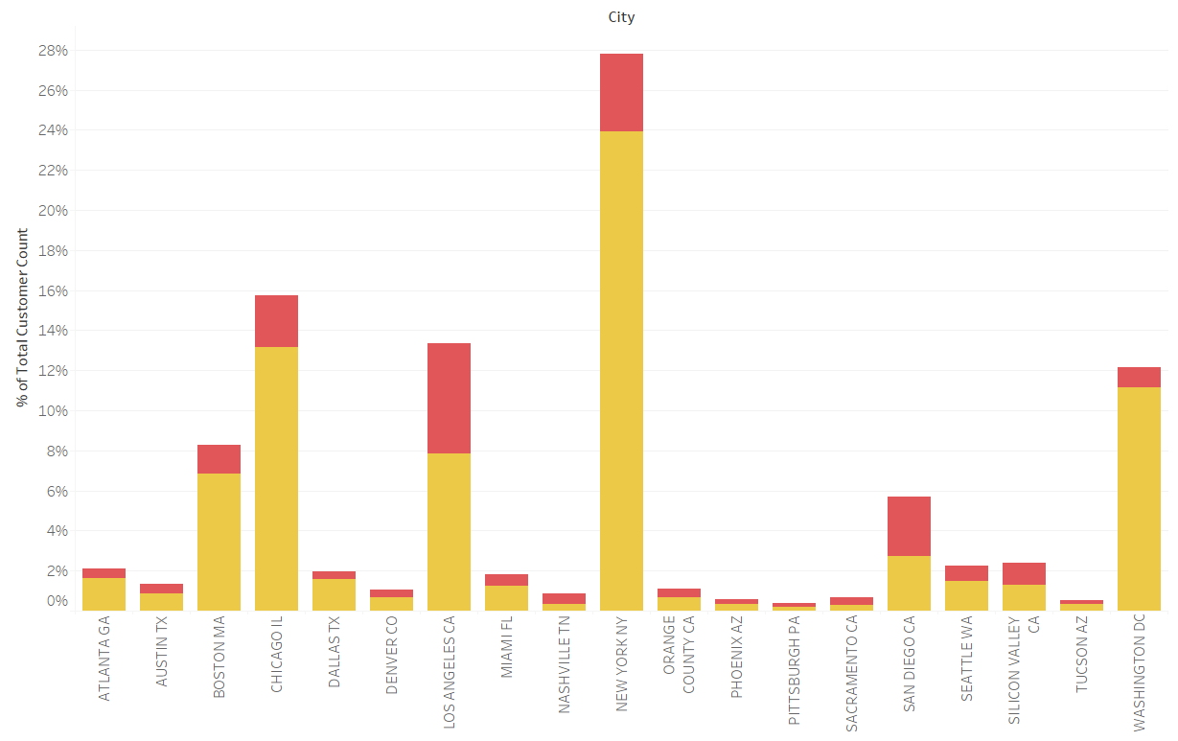
EDA Results
1. Market Analysis: Demand by City
Observations:
Except for Boston and Washington, less than 10% of the population uses cabs.
Pink Cab has more users than Yellow Cab in only four cities.
Out of the total cab users, Yellow Cab covers 9.46% while Pink Cab covers 7.68% of the market. This shows an ample opportunity for growth for both the companies.

Slide 8
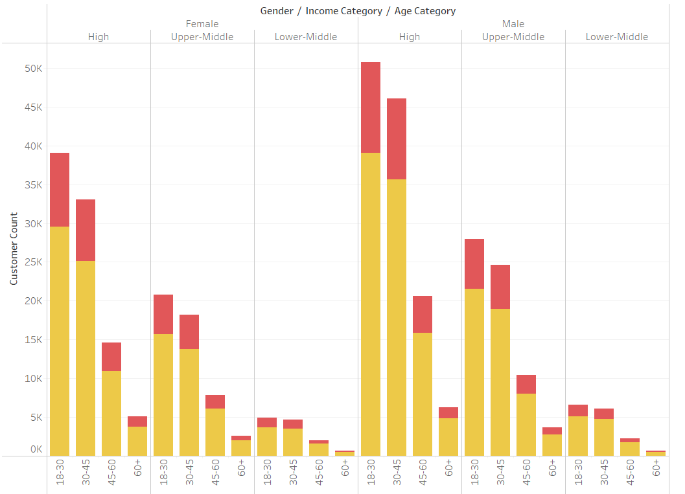
EDA Results
1. Market Analysis: Customer Segmentation
Observations:
Customer analysis shows that Yellow Cab outperforms Pink Cab across all customer segments.
Males in the age range 18-30 with High Income seem to be the most frequent users of cabs.
Most users seem to belong to high income class.
The Number of cab users seems to be decreasing with age.
Males seem to be using the cabs more than females.

Slide 9
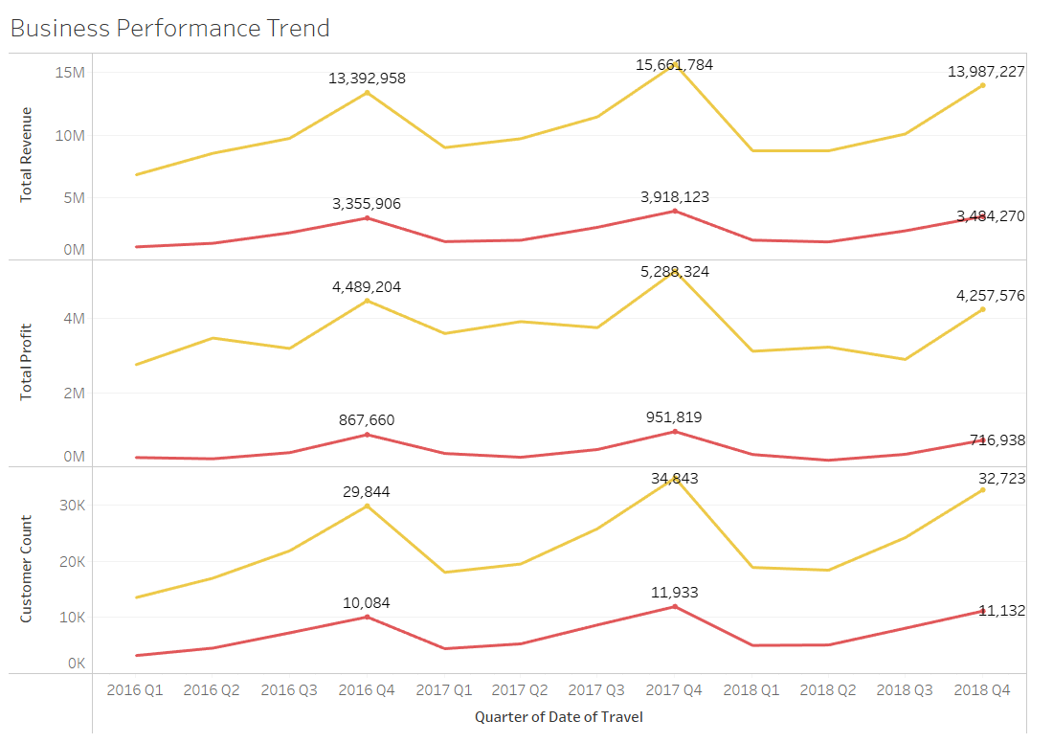
EDA Results
2. Cab Business Analysis: Business Performance Trend
Observations:
Yellow Cab has brought in more revenue, has been more profitable and has had more users than Pink Cab.
Both the companies saw an increase in revenue in 2016-17 but saw a decrease in revenue from 2017-18. This can be explained by the similar trend in number of users.

Slide 10
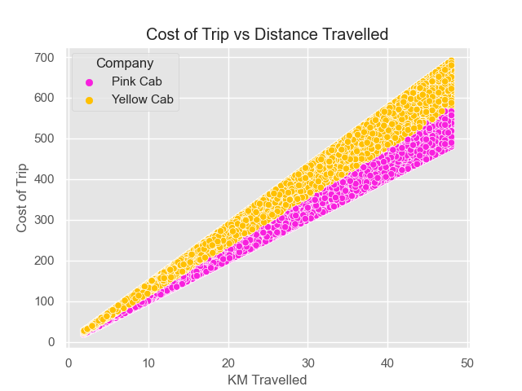
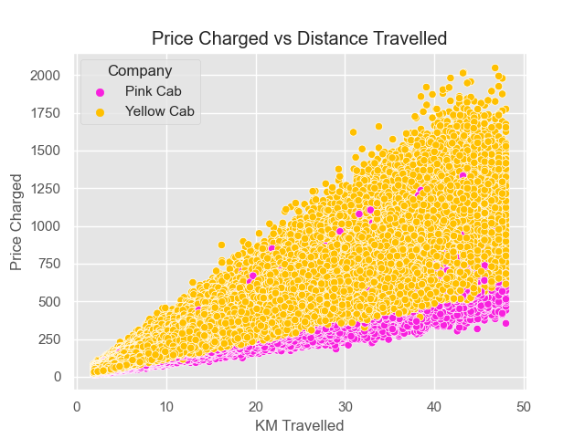
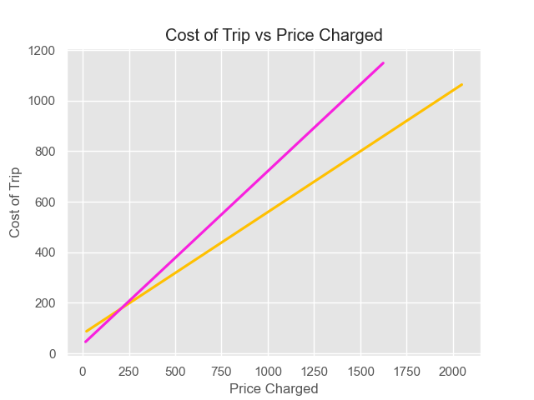
EDA Results
2. Cab Business Analysis: Relation between Distance, Cost and Price
Observations:
As expected, both the price charged and the cost of trip seem to be highly positively correlated with the Distance of trip.
Price Charged per unit cost of trip seems to be more for Pink Cab than for Yellow Cab. This could explain the higher number of users for Yellow Cab.

Slide 11
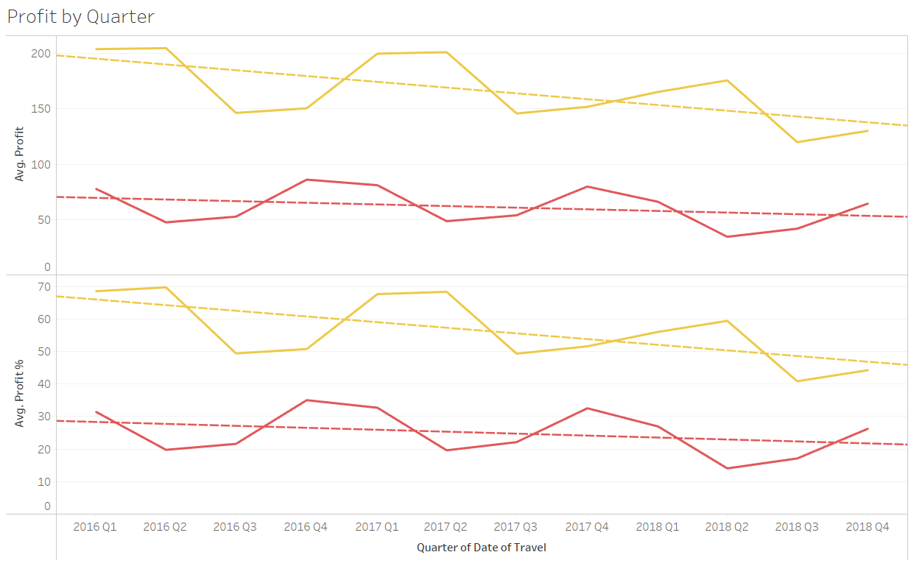
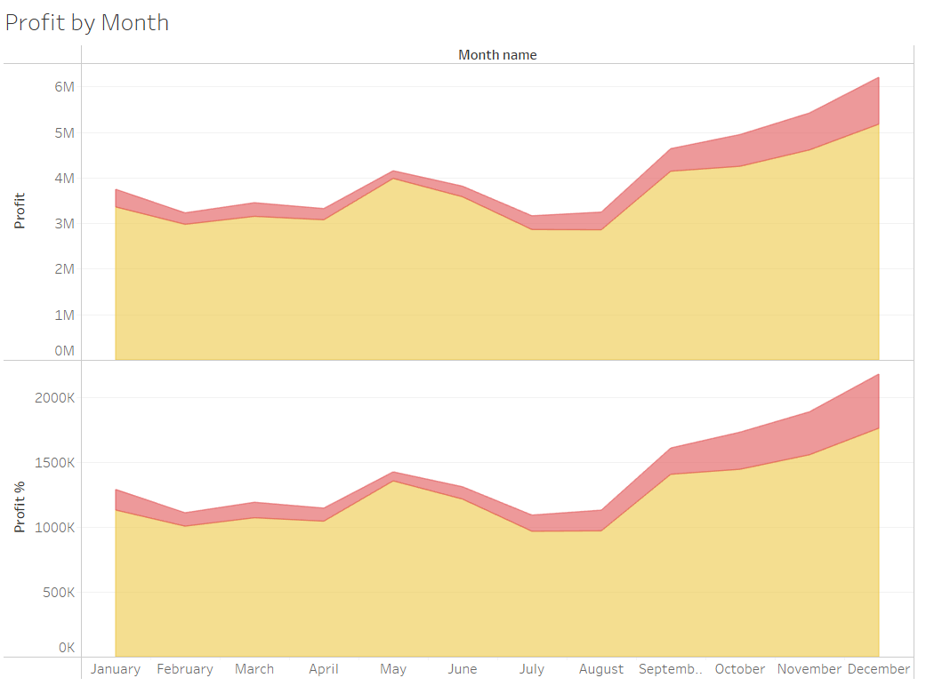
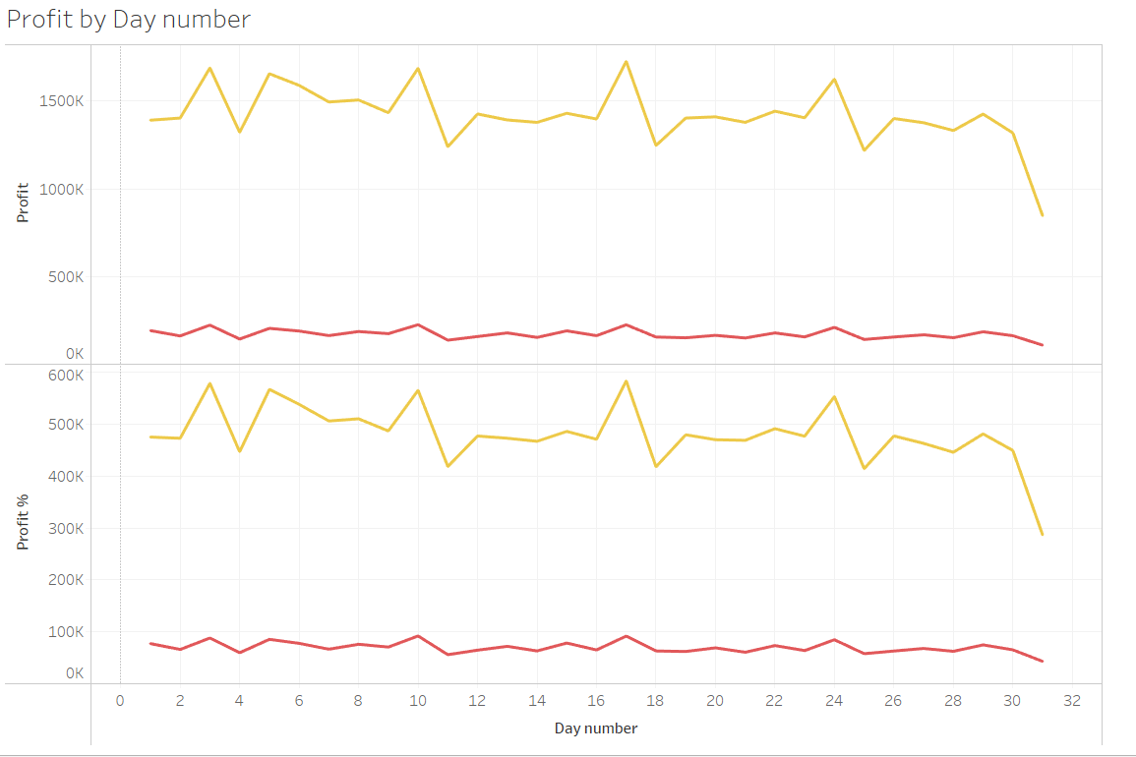
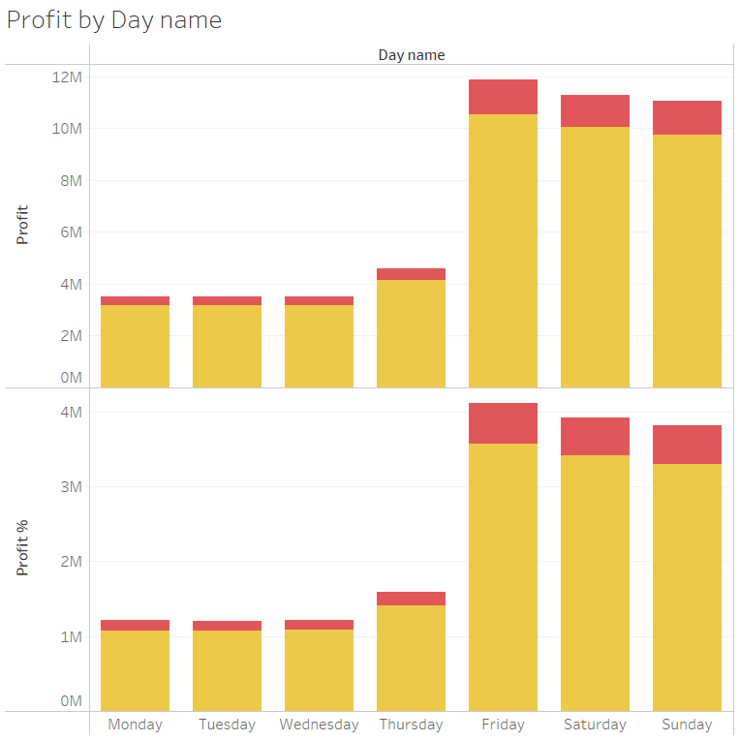
EDA Results
3. Seasonal Analysis: Average Profit Trend
Observations:
Yearly Profit trend shows that although Yellow Cab has experienced a decrease in average profit over the years, it has still outperformed Pink Cab by a significant margin.
Analyzing average profit earned in each month revealed that there were a few months that observed a decrease in Profit for Yellow Cab and an increase in Profit for the Pink Cab. This might be due to discounts offered by Pink Cab during those months.
Both the companies saw an increase in Profit in the months of winter and on weekends.
Since only around half the months have 31 days, steep decline in average profit on day number 31 is observed.

Slide 12
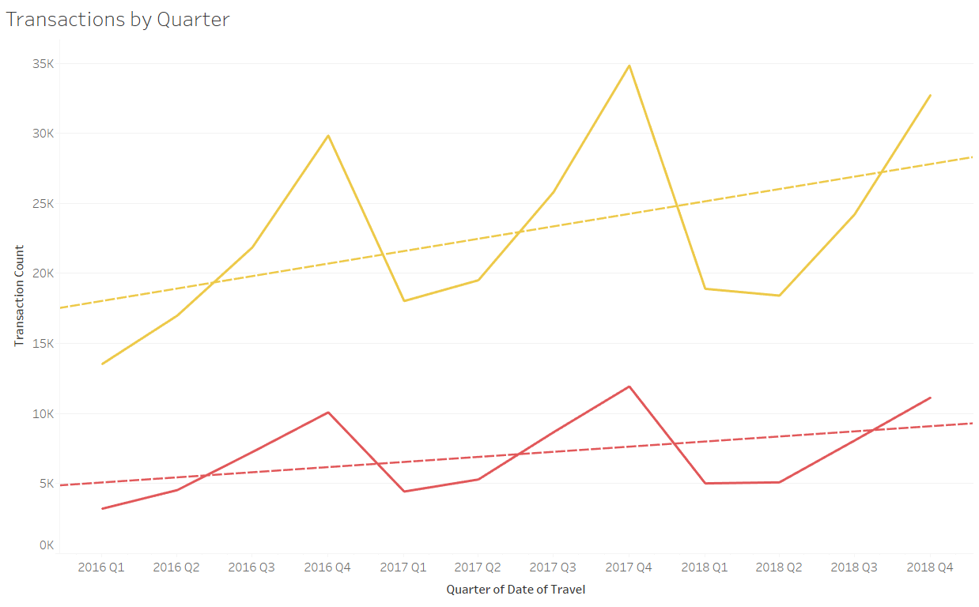
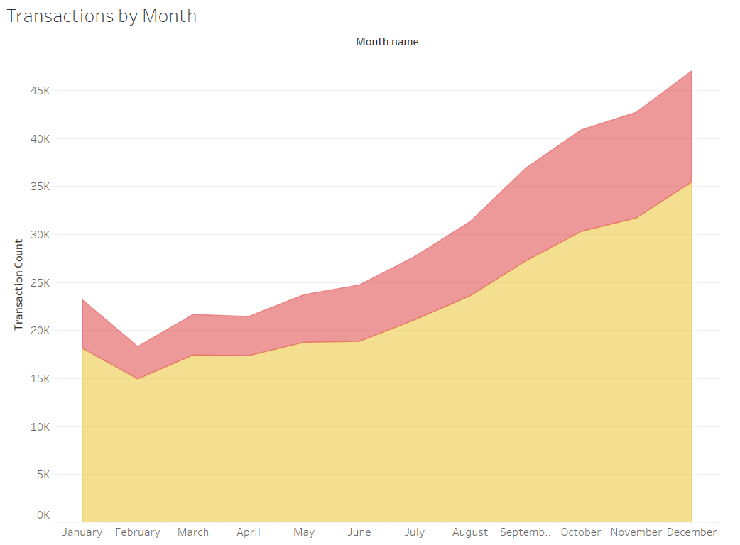
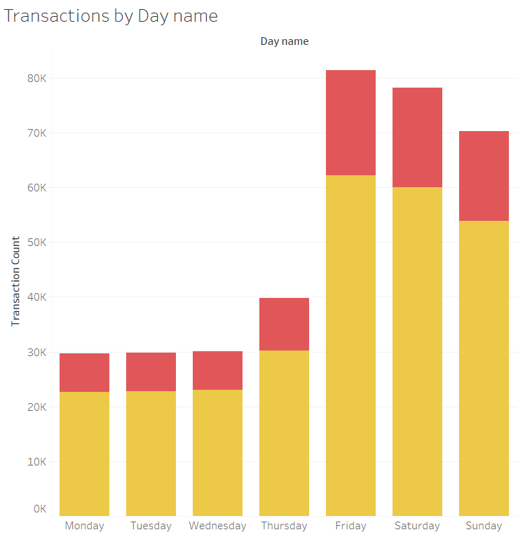
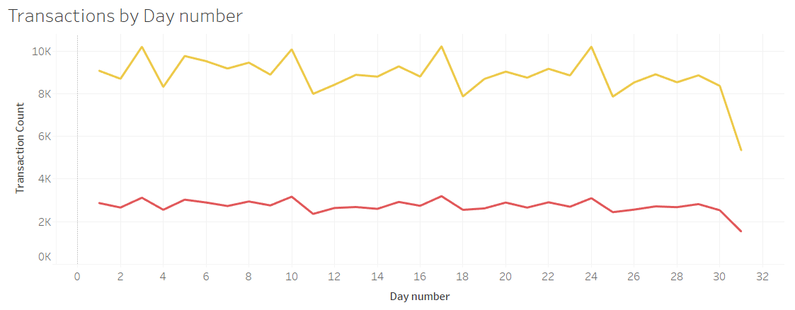
EDA Results
3. Seasonal Analysis: Demand Trend
Observations:
Yellow Cab has shown more yearly growth than Pink Cab.
Yellow Cab has more demand than Pink Cab across all the months.
Both the cab companies seem to experience a similar yearly trend in demand, lower at the start of the year and peaking near the tail-end (months of winter).
Similar trend is observed in daily demand, with demand significantly higher on weekends than on weekdays

Slide 13
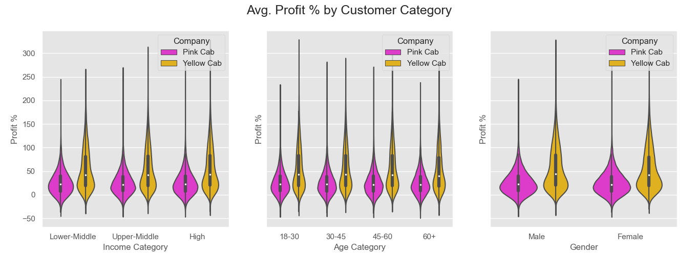
EDA Results
4. Customer Analysis: Average Profit by Customer Category
Observations:
Customer analysis shows that Yellow Cab outperforms Pink Cab across all customer segments.
Average Profit % seems to be nearly same across all customer segments.

Slide 14
Hypotheses Testing
1. Exploring Profit Variation
Hypothesis | Result | Conclusion
Does Gender affect the profit made? | P value for Yellow Cab: 0.0000 P-value for Pink Cab: 0.1152 | The difference in profit by gender is more prominent for Yellow Cab than for Pink Cab
Does the age category affect the profit made? | P value for Yellow Cab: 0.0000 P value for Pink Cab: 0.2593 | The difference seems to be most prominent between Senior Adult Yellow Cab Users and other Yellow Cab Users.
Does the income category affect the profit made? | P value for Yellow Cab: 0.0000 P value for Pink Cab: 0.5324 | The difference seems to be most prominent among High-Income Yellow Cab Users and other Yellow Cab Users.

Slide 15
Hypotheses Testing
2. Exploring Seasonal Variation
Hypothesis | Result | Conclusion
Does the time of year affect the average distance of trip? | p-value for entire dataset: 0.8022 | The average KM Travelled is the same across different time of year (month-year) categories.
Does the time of year affect the average price charged? | P-value for Yellow Cab: 0.0000 P-value for Pink Cab: 0.0000 | For Yellow Cab: The prices charged are higher than pink cab. The trend shows higher charges in spring and lower charges in summer. This variation could be to counter losses in off-season during spring as compared to summer. Company could be offering discounts in the winter since this explains lower profitability in that time in spite of higher demand. For Pink Cab: The prices charged are lower than yellow cab. The trend shows lower charges in spring and higher charges in summer. The lower charges could have been done to attract the yellow cab users during spring. The higher charges could be to counter the losses of spring since summer has more demand. Company could be offering discounts in the winter since this explains lower profitability in that time in spite of higher demand.

Slide 16
Hypotheses Testing
3. Exploring Other possible variations
Hypothesis | Result | Conclusion
Is Payment Mode associated with any other categorical features? | P value for Income Category: 0.9229 P-value for Age Category: 0.3291 P-value for Gender: 0.9645 P-value for Distance Category: 0.2900 P-value for Company: 0.5412 P-value for City: 0.1042 P-value for Month name: 0.3490 | The distribution of Payment Mode is same across all the categories
Is Distance Category associated with any other categorical features? | P value for Income Category: 0.7485 P-value for Age Category: 0.2502 P-value for Gender: 0.9208 P-value for Payment Mode: 0.2900 P-value for Company: 0.9677 P-value for City: 0.5275 P-value for Month name: 0.8048 | The distribution of Distance Category is same across all the categories

Slide 17
EDA Recommendation
Recommendation: Invest in Yellow Cab
It is obvious from the EDA that the Yellow Cab outperforms Pink Cab in almost all aspects. The following reasons strongly support the choice of Yellow cabs for investment:
Yellow Cabs only cover 9-10% of the total consumer market on average. This means that majority of the market still remains untapped which signifies room for growth.
Yellow Cabs have increased their total profit over the years even though average profit has slightly decreased. This shows Yellow cabs' success in customer acquisition over the years. This is also evident from the rise in number of Yellow Cab Customers over the years.
Yellow Cab customers seem to have significantly more trips than Pink Cab customers and the average distance travelled is same. This shows Yellow Cab has also been successful in customer retention.
Customers seem to have more trust in Yellow Cabs due to their better pricing model. This has resulted in higher number of customers and higher revenue for Yellow Cab.

Slide 18
Thank You

